Slide 1
Planet 50-50 by 2030
Step it up for Gender Equality

Slide 2
Agenda 2030
Gender Equality is key to achieve Sustainable Development Goals

Slide 4
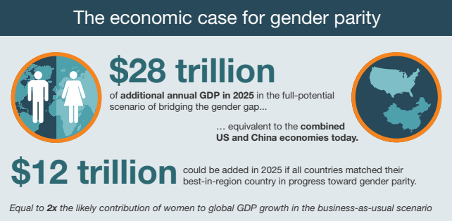
Higher Economic Growth Rates
…The world as a whole could increase global GDP
by US$5.3 trillion by 2025 by closing the gender gap in
economic participation by 25% over the same period.
The power of Parity Mckinsey Global Institute - 2015
World Ecomomic Forum - Gender Gap Report 2017

Slide 5
Gender Equal States – More peaceful and Stable States
The more gender equality
The more likely conflict will be resolved without violence
The less likely a state is to use military force to resolve International disputes
The more likely grievances will be prevented from escalating into violent conflict
The less likely a state is to use military force to resolve International disputes
The larger the gender gap
The more likely a nation is to be involved in inter and intra-state conflict
The more likely a nation is to use violence as a first response in a conflict setting
The more likely post conflict Peace will be more fragile
The more likely that violence during the conflict will be more severe
Source: Crespo-Sancho, C. 2017. “The Role of Gender in the Prevention of Violent Conflict.” Background paper for the United Nations-World Bank Flagship Study, Pathways for Peace: Inclusive Approaches to Preventing Violent Conflict. World Bank, Washington, DC. - http://blogs.worldbank.org/dev4peace/can-gender-equality-prevent-violent-conflict

Slide 6
Equality is the smartest decision for business
Human Rights
Legislation and Stakeholders
Better results
Best talents
Consum
Risco e Inovação

Slide 7
2017 Global Gender GAP Ranking
1.
2.
3.
4.
5.
6.
7.
8.
9.
10.
11.
12.
13.
14.
16.
Ireland
New Zealand
Philippines
France
Germany
Namibia
Denmark
Canada
Bolivia
South Africa
Colombia
Costa Rica
United States
Chile
Mexico
Brazil
Iceland
Norway
Finland
Rwanda
Sweden
Nicaragua
Slovenia
17.
21.
36.
41.
49.
63.
81.
90.
Fonte: http://www3.weforum.org/docs/WEF_GGGR_2017.pdf

Slide 8
GENDER GAP
Labor Force Participation
Global
Non paid care work (hours/day)
76% MEN
1:20 MEN
49% WOMEN
4:30 WOMEN
ILO (2016)
World Bank (2017)
Women subjected to Physical / sexual violence
Global
Global Gross Enrolment in
Tertiary Education
Global
34% MEN
35% WOMEN
38% WOMEN
WHO (2013).
UNESCO (2015)

Slide 9
GENDER GAP
BRASIL
(ETHOS)
WOMEN IN S&P 500 COMPANIES
5.2%
14%
CEOs
11%
23%
TOP EARNERS
11%
21.2%
BOARD SEATS
EXECUTIVE/SENIOR LEVEL
OFFICIALS AND MANAGERS
26.5%
DIFERENÇA SALARIAL
31-39%
ILO (2016)
FIRST/MID LEVEL OFFICIALS
AND MANAGERS
36.9%
35%
TOTAL EMPLOYEES
44.7%

Slide 10
GENDER GAP – BOARD SEATS
Source: Global Summit of Women & Corporate Women Directors International

Slide 11
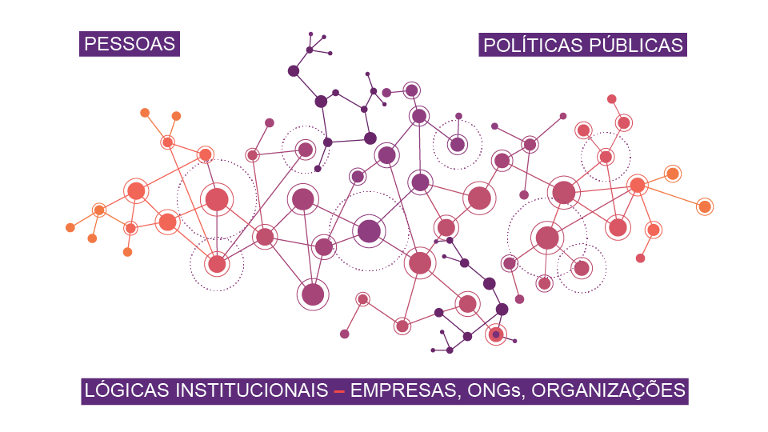
PEOPLE
PUBLIC POLICIES
INSTITUONAL LOGIC – COMPANIES, ONG, GOVERNMENT ENTITIES

Slide 12
WIN-WIN
EQUALITY MEANS GOOD BUSINESS

Slide 13
European Union
The programme is aligned to the objectives of the European Union Partnership Instrument within its strand of Responsible Business and Decent Work
Support businesses, employers, workers and trade unions to address gender inequality faced by women in the working environment

Slide 14
European Union
The European Parliament Committee on Women's Rights and Gender Equality
In-depth analysis note: “Women's Economic Empowerment at International Level”
Women’s economic empowerment makes a sound case for investment of development cooperation resources

Slide 15
European Union
European Investment Bank
The EIB Group Strategy on Gender Equality and Women’s Economic Empowerment
New European Consensus on Development
Recognizes gender equality as key driver for change

Slide 16
UN Women’s strategic plan
Outcome 3: Women have income security, decent work,
and economic autonomy
Address disproportionate share of unpaid domestic and care work
Address gender pay gap
Promote the voice and representation for women, including through trade unions
More women own, launch and/or manage enterprises

Slide 17
UN Women’s strategic plan
Outcome 3: Women have income security, decent work,
and economic autonomy
Women’s access to digital, financial, technical and vocational education and training opportunities
Leverage public and private procurement processes
Increasing levels of commitment by employers to the Women’s Empowerment Principles

Slide 18
ILO programme
Outcome 10: Strong and representative employers’ and workers’ organizations
“Advocacy with employer and business organizations will continue to make the business case for promoting gender equality and diversity in the workplace, increasing participation of women in governance structures and fostering women entrepreneurship through an adapted business environment.”

Slide 19
OBJECTIVE
Contribute to the economic empowerment of women
by recognizing women as beneficiaries and partners of growth and development
increasing private sector’s commitment to gender equality and women’s empowerment
strengthening its capacities to implement these commitments

Slide 20
WIN WIN
Equaiity Means good Business
Empowerwomen.org
Welearnwomen.org
WEPS
Women Entrepreneurship Devlopment
Get Ahead
HeForShe
Women in Business Management
The power of procurement
Women Economic Empowerment

Slide 21
Guiding platform
The Women Empowerment Principles (WEPs)
Created by UN Women and the Global Compact in 2010
Framework to engage private sector companies to contribute to the achievement of the Agenda 2030
Promote gender equality in the workplace, marketplace and community

Slide 22
Women’s Empowerment Principles
2
1
3
Treat all women and men fairly at work – respect and support human rights and nondiscrimination
Establish high-level corporate leadership for gender equality
Ensure the health, safety and well-being of all women and men workers
4
5
6
7
Promote education, training and professional development for women
Implement enterprise development, supply chain and marketing practices that empower women
Promote equality through community initiatives and advocacy
Measure and publicly report on progress to achieve gender equality

Slide 23
The journey: from principles to practice
Internal
HR and CSR actions
Action
Plan
Value Chain
Commitment
at high level
Self
diagnosis
Community
CEO Statement of Support
Imple-mentation
HEFORSHE
Results
WEPs GAP Analysis Tool
SELOS E PRÊMIOS

Slide 24
1854
WEPs SIGNATORY
COMPANIES
165
BRAZIL

Slide 25
LOCAL & GLOBAL
Accenture
Avon
Bayer
Braskem
Carrefour
Coca-Cola
Communis
Deloitte
KPMG
BNP Paribas
PWC
Schneider Electric
Unilever
B.drops
B2BR
B3
Banco BNP Paribas
Banco Bradesco
Banco do Brasil
Banco Itaú
Banco Sumitomo Mitsui
BETC
Bianchi Comunicação
BolsaCheia
Bombril
Brenntag
BRK Ambiental
Caixa Econômica
Ceva Logistics
Chemtech
CINQ Tech.
CKZ Eventos
Cobram
CPRM
CONSULNEGI
COPAGAZ
Copel
Cosmezi
Correios
DPZL advogados
Dell Computadores
Demarest
Drexell S/A
DCX Technology
Dupont
EBFlora
EDP Energia
Eletrobrás
Eletrobrás Amazonas
Eletrobrás CEPEL
Eletrobrás Chesf
Eletrobrás Acre
Eletrobrás Alagoas
Eletrobrás Piauí
Eletrobrás Rondônia
Eletrobrás Roraima
Eletronorte
Eletronuclear
Eletrosul
Eletropaulo
ELETROS
Embrapa
ENEL
Fersol
Fox Time
Furnas
Furukawa
Gerdau
Global Web
Outsourcing Br.
Grupo Pão de Açuçar
Great Place to Work
Groscon
Grupo Boticário
Grupo Criarq
Grupo Segurador BB Mafre
Hays
Heads
Home Care
Hospital O. Octavio Lobo
Hospital P. E. Galileu
Hotel Terras Altas
IBM
Inpress
INCCATI
Itaipu Binacional
Itapoá Terminais
J&J
Johnson Controls
Kimberly-Clark
Lab. Sabin
Leroy Merlin
Lima, L. C. Adv.
Lojas Renner
Magazine Luiza
Maltoni
Mantris
Maquina Cohn&Wolfe
Mattos Filho
Mauricio de Sousa Prod.
Merck
MicroLife
Microsoft
Monsanto
Move On Intimates
NATU'SFRAN
Natura
Netza
New Space
NFE do Brasil
N.E.L. e M. Adv.
Novelis
Odontoprev
Pandora
Papo de Homem
PayPal
Pepsico
Petrobras
Planeta Imag.
Portal Publicidade
Proseftur
Publicis
Real Grandeza
Rede Mulher - RME
Renault
Rodovalho Adv.
Sanepar
Santander
Sealed Air
Selem, B. Cons.
Serasa Experian
SERPRO
SESI-PR
Soc. B. Albert
Einstein
Sodexo
Softtek
Superela
Talenses
TE Connectivity
Telefônica-Vivo
Tempo de
Mulher
Trampos.Co
Unimed Londrina
Val Rocha Eng.
Vale S.A.
Veirano
Visão Sustentável
W3Haus
Walmart
Whirlpool
White Martins
Wine
LOCAL
Abbott Brasil
Açovisa
ADBV
AES Brasil
AES Tietê
AIG Seguros
Amazon
Ambev
Apetite
Arcos Dourados - Mc
Astra Zeneca
Atento
Avianca

Slide 26
ADRIANA CARVALHO
ONU MULHERES BRASIL
adriana.carvalho@unwomen.org
THANK YOU!

